Slide 1
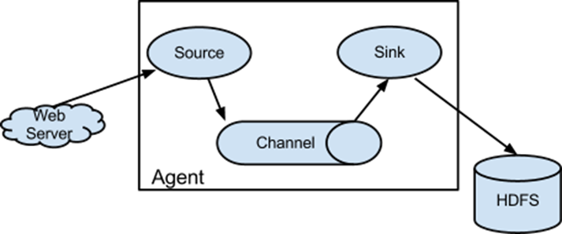
Flume
A push distributed message(event) system
A flume process
A agent
Client

Slide 2
Flume
Flume is a distributed, reliable, and available service for aggregating, and moving large amounts of log data.
Simple and flexible architecture based on streaming data flows.
Robust and fault tolerant with tunable reliability mechanisms and many failover and recovery mechanisms.

Slide 3
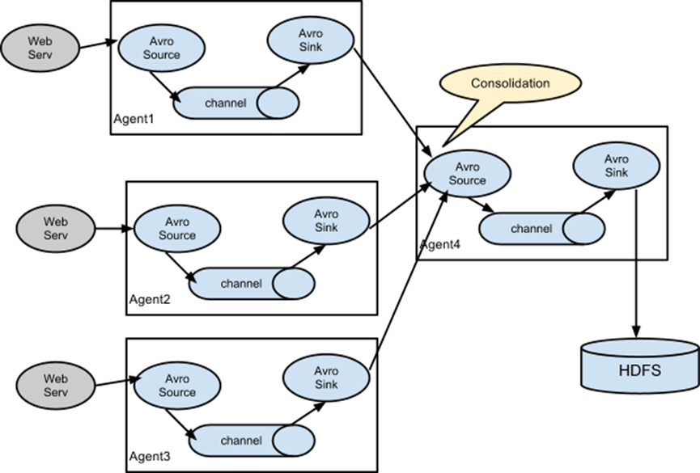
Flume

Slide 4
Configuration

Slide 5
Custom Configuration
a1.sources = r1
a1.sinks = k1
a1.channels = c1
# Describe/configure the source
a1.sources.r1.type = avro (this also can customize, but this use avro)
a1.sources.r1.bind = localhost
a1.sources.r1.port = 6666
# Describe the sink
a1.sinks.k1.type=<pachagename>.<classname>
# Use a channel which buffers events in memory
a1.channels.c1.type=memory
a1.channels.c1.capacity=1000
a1.channels.c1.transactionCapacity=100
# Bind the source and sink to the channel
a1.sources.r1.channels = c1
a1.sinks.k1.channel = c1
# customize my config
a1.sinks.k1.<property_key>=<property_value>

Slide 6
Code Sink and Client Review
https://flume.apache.org/FlumeDeveloperGuide.html
Search MySink
Search RPC clients - Avro and Thrift

Slide 7
Deploy Command
BINDIR=`dirname $0`
XXXX_HOME=${XXXX_HOME:="$(cd $BINDIR/.. && pwd)"}
$FLUME_HOME/bin/flume-ng agent --conf conf --conf-file XXXX.conf --name a1 -Dlogger.output=$XXXX_HOME/log -Xms128m -Xmx256m --classpath "$XXXX_HOME/XXX/:$XXXX_HOME/YYY"

Slide 8
Reference
http://flume.apache.org/FlumeUserGuide.html#flume-sources
http://flume.apache.org/FlumeUserGuide.html#flume-sinks
https://flume.apache.org/FlumeDeveloperGuide.html

